Slide 1
NETWORK SECURITY
TARIKUZZAMAN EMON
ASSISTANT PROFESSOR
STAMFORD UNIVERSITY BANGLADESH

Slide 2
Security Basic
What is security?
Security means the prevention of and protection against assault, damage, fire, fraud, invasion of privacy, theft, unlawful entry, and other such occurrences caused by deliberate action.
Therefore, the quality or state of being secure- to be free from danger, is called security.
A successful organization should have multiple layers of security in place:
Physical security
Personal security
Operations security
Communications security
Network security
Information security

Slide 3
Security Basic
Categorizing security in IT Arena:
In the field of information technology, security can be categorized into a number of ways:
Computing security
Application security
Operating System security
Network security
Database security
Information security

Slide 4
Security Basic
What is computer security?
Answer depends upon the perspective of the person you’re asking-
Network administrator has a different perspective than an end user or a security professional.
“A computer is secure if you can depend on it and its software to behave as you expect”.
Computer security means all the processes and mechanisms by which computer-based equipments, information stored in the computer and services provided by the computer are protected from unintended or unauthorized access, change or destruction.
Computer security also refers to techniques in which a computer system is protected from data corruption, destruction, interception, loss, or unauthorized access.
Computer security deals with computer-related assets that are subject to a variety of threats and for which various measures are taken to protect those assets.

Slide 5
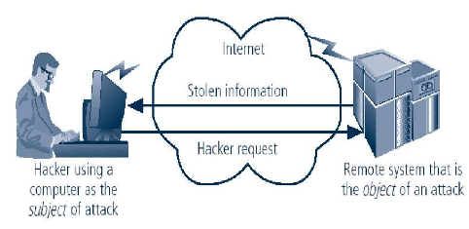
Security Basic
Computer can be either a subject and/or an object of an attack.
When the subject of an attack, computer is used as an active tool to conduct attack.
When the object of an attack, computer is the entity being attacked.
Computer as the Subject and Object of an attack

Slide 6
Security Basic
Physical security:
Computer equipments and its data need to be protected from physical harm. Hazards could include natural ones such as fire, lighting, water damage etc, and can also include deliberate damage or theft.
Computer theft:
Although there are many ways of making sure that unauthorized people are denied access to a system through the use of keyboard locks, password, etc, it is more difficult to prevent a thief from picking up a system and stealing it. Locks, bolts, clamps, alarmed circuits and tags are all methods of hardware protection.

Slide 7
Security Basic
What is Application Security?
Application security encompasses measures taken throughout the application's life-cycle to prevent exceptions in the security policy of an application or the underlying system through flaws in the design, development, deployment, upgrade, or maintenance of the application.
Applications only control the use of resources granted to them. They determine the use of these resources by users of the application through application security.
Principle approach for application security includes:
Knowing your threats.
Securing the network, host and application.
Incorporating security into your software development process.

Slide 8
Security Basic
What is Operating System Security?
In a standalone computer system, all resources, data, application and users are OS-oriented.
OS is responsible for communicating with the hardware and users.
It safeguards data and applications stored in primary and secondary memory, properly manages various resources of the computer system, and establishes connection to other computer systems via the network. Therefore, OS is responsible for total operation of a computer system.
As OS is responsible for the total operation of a computer system, so, it is the weak point for the information pirates.
Flaws, commonly called 'bugs' or 'security holes', in the operating system on your computer (think Windows or Mac OS X) are being discovered almost daily.

Slide 9
Security Basic
What is Network Security?
The computer networks, both public and private, are used every day to conduct transactions and communications among businesses, government agencies and individuals.
The networks are linked by communication systems, some of which might be private, such as within a company and others which might be open to public access.
Network security refers to any activities designed to protect your network. Specifically, these activities protect the usability, reliability, integrity, and safety of your network and data. Effective network security targets a variety of threats and stops them from entering or spreading on your network.
An effective network security strategy requires identifying threats and then choosing the most effective set of tools to combat them.

Slide 10
Security Basic
What is Internet Security?
Internet security is measures to protect data during their transmission over a collection of interconnected networks.

Slide 11
Security Basic
What is Database Security?
Database security means protecting a database from destructive forces and the unwanted actions of unauthorized users.
Some data security technologies include:
Disk Encryption
It refers to encryption technology that encrypts data on a hard disk drive.
Hardware based Mechanisms for Protecting Data
Software based security solutions encrypt the data to prevent them from being stolen. However, a malicious program or a hacker may corrupt the data in order to make it unrecoverable, making the system unusable. Hardware-based security solutions can prevent read and write access to data and hence offers very strong protection against tampering and unauthorized access.
Backups
Backups are used to ensure data which is lost can be recovered.
Data Masking
It is the process of obscuring or masking specific data within a database to ensure that data security is maintained and sensitive information is not exposed to unauthorized personnel.
Data Erasure
It is a method of software-based overwriting that completely destroys all electronic data residing on a hard drive or other digital media to ensure that no sensitive data is leaked when an asset is retired or reused.

Slide 12
Security Basic
What is Information Security?
The protection of information and its critical elements, including systems and hardware that use, store, and transmit that information.
In information technology, security is the protection of information assets through the use of technology, processes, and training.
Necessary tools for Information Security:
Policy
Awareness
Training
Education
Technology

Slide 13
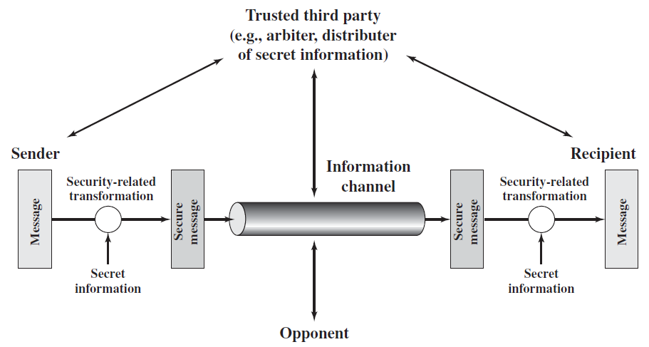
A Model for Network Security
A model for network security is shown in the figure.
A message is to be transferred from one party to another across some sort of Internet service.
Figure: A model for network security
The two parties, who are the principals in this transaction, must cooperate for the exchange to take place.
A logical information channel is established by defining a route through the Internet from source to destination and by the cooperative use of communication protocols (e.g., TCP/IP) by the two principals.

Slide 14
A Model for Network Security
Security aspects come into play when it is necessary or desirable to protect the information transmission from an opponent who may present a threat to confidentiality, authenticity, and so on.
All of the techniques for providing security have two components:
A security-related transformation on the information to be sent.
Examples include the encryption of the message, which scrambles the message so that it is unreadable by the opponent, and the addition of a code based on the contents of the message, which can be used to verify the identity of the sender.
Some secret information shared by the two principals and, it is hoped, unknown to the opponent.
An example is an encryption key used in conjunction with the transformation to scramble the message before transmission and unscramble it on reception.

Slide 15
A Model for Network Security
A trusted third party may be needed to achieve secure transmission. For example, a third party may be responsible for distributing the secret information to the two principals while keeping it from any opponent. Or a third party may be needed to arbitrate disputes between the two principals concerning the authenticity of a message transmission.
This general model shows that there are four basic tasks in designing a particular security service:
Design an algorithm for performing the security-related transformation. The algorithm should be such that an opponent cannot defeat its purpose.
Generate the secret information to be used with the algorithm.
Develop methods for the distribution and sharing of the secret information.
Specify a protocol to be used by the two principals that makes use of the security algorithm and the secret information to achieve a particular security service.

Slide 16
Critical characteristics of information security
Information is an asset that has a value like any other asset. The value of information comes from the characteristics it possesses:
Availability
Accuracy
Authenticity
Confidentiality
Integrity
Utility
Possession

Slide 17
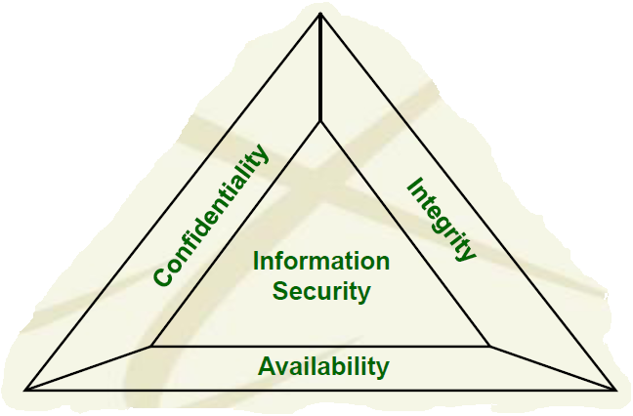
The CIA and DAD Triads of information security
CIA Triad:
The core concepts of information security are confidentiality, integrity, and availability. These principals are known as the CIA triad and are the foundation for combating the DAD triad.
CIA Triad or Triangle:
Confidentiality:
Confidential information should not be accessible to unauthorized users. That is, messages sent by Alice to Bob should not be readable by Eve.
Integrity:
Ensuring that data may only be modified through an authorized means. That is, Bob should be able to detect when data sent by Alice has been modified by Eve.
Availability:
Authorized users should be able to access data for legitimate purposes as necessary.
Figure: CIA Triad

Slide 18
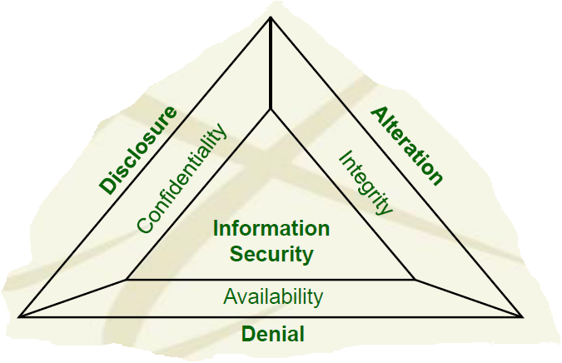
The CIA and DAD Triads of information security
DAD Triad or Triangle:
DAD triad provides means for defeating the security of an organization.
Malicious hackers have developed their own triad, the DAD triad, to counter the CIA triad of security professionals.
Each leg of the DAD triad is targeted at defeating the mechanisms associated with one leg of the CIA triad.
Having a good understanding of the CIA triad also means understanding the DAD triad that opposes the CIA triad.
Disclosure:
Unauthorized individuals gain access to confidential information.
Alteration:
Data is modified through some unauthorized mechanism.
Denial:
Authorized users cannot gain access to a system for legitimate purposes.
Figure: DAD Triad

Slide 19
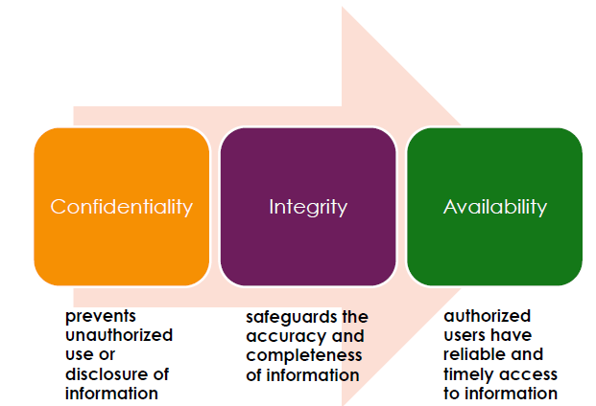
Goals of Information Security
Three main goals of information security are:
Other goals are: authentication, non-repudiation, anonymity etc.

Slide 20
Security Goals of Information
Confidentiality:
Confidentiality is probably the most common aspect of information security.
It means keeping data secret from all but those authorized to see it—messages sent by Alice to Bob should not be readable by Eve.
We need to protect our confidential information. For example, an organization needs to guard against those malicious actions that endanger the confidentiality of its information.
Confidentiality is applicable to stored information as well as information that is to be transmitted. When we send a piece of information to be stored in a remote computer or when we retrieve a piece of information from a remote computer , we need to conceal it during transmission.
Examples:
In military, concealment of sensitive information is the major concern.
In industry, hiding some information from competitors is crucial to operation of the organization.
In banking, customers’ accounts need to be kept secret.

Slide 21
Security Goals of Information
Integrity:
It means ensuring that data has not been altered by unauthorized means— Bob should be able to detect when data sent by Alice has been modified by Eve.
Even if the sender and receiver are able to authenticate each other, they also want to insure that the content of their communication is not altered, either maliciously or by accident, in transmission.
Information needs to be changed constantly. For example, in a bank, when a customer deposits or withdraws money, the balance of her account needs to be changed.
Integrity means that changes need to be done only by authorized entities and through authorized mechanisms.
Integrity violation is not necessarily the result of a malicious act; an interruption in the system, such as a power failure, may also create unwanted changes in some information.

Slide 22
Goals of Information Security
Availability:
Information is useless if it is not available. The unavailability of information is just as harmful for an organization as the lack of confidentiality or integrity. Imagine, what would happen to a bank if the customers could not access their accounts for transactions.
Therefore, the information created and stored by an organization needs to be available to authorized entities.
Information needs to be changed constantly, which means it must be accessible to authorized entities.

Slide 23
Aspect of Security
Consider three aspects of information security:
Security attack:
Any action that compromises the security of information owned by an organization is termed as security attack.
Security service:
Security service enhances the security of data processing systems and information transfers of an organization. It is intended to counter security attacks using one or more security mechanisms
Security mechanism:
To detect, prevent, or recover the information and information system from various security threats, security mechanisms are used.

Slide 24
Security Attack
What is Security Attack?
Any action that compromises the security of information owned by an organization is termed as security attack.
Threat and attack are often used to mean the same thing.
Information security is about how to prevent attacks, or failing that, to detect attacks on information-based systems.

Slide 25
Kinds of Security Attacks
The three goals of information security- confidentiality, integrity, and availability - can be threatened by security attacks.
They can be classified using different approaches. Two approaches are mentioned here.
Category of attacks based on the security goals:
There are three groups of attacks based on the security goals. These are:
1. Attacks threatening confidentiality
2. Attacks threatening integrity
3. Attacks threatening availability
Category of attacks based on their effects on the system:
There are two groups of attacks based on their effects on the system. These are:
1. Passive attacks
2. Active attacks

Slide 26
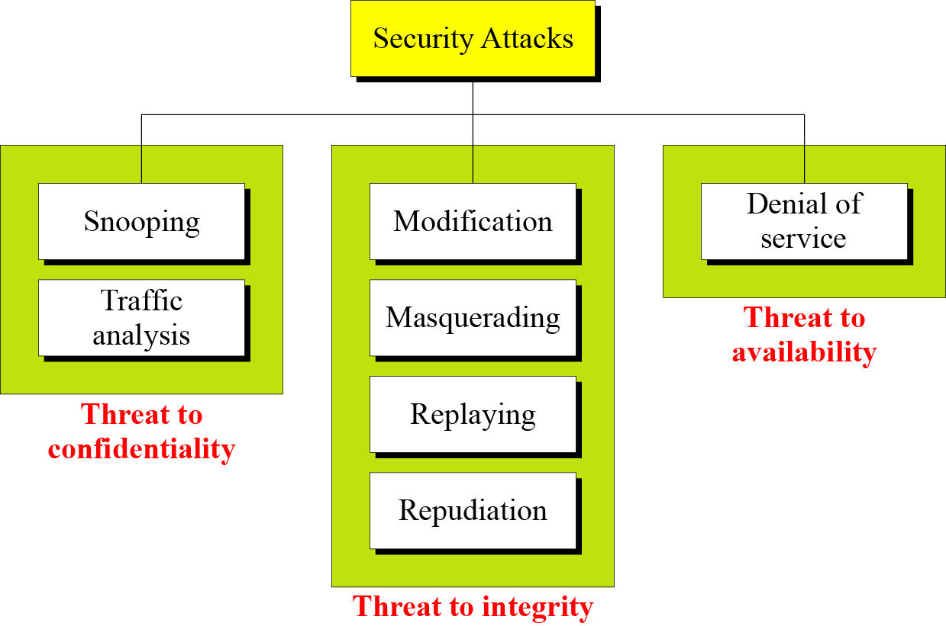
Attacks Based on the Security Goals
Figure below shows the taxonomy of attacks based on the security goals:
1. Attacks Threatening Confidentiality
- Snooping
- Traffic analysis
2. Attacks Threatening Integrity
- Modification
- Masquerading
- Replaying
- Repudiation
3. Attacks Threatening Availability
- Denial of service
Figure: Taxonomy of attacks with relation to security goals

Slide 27
Attacks Based on the Security Goals
Attacks Threatening Confidentiality:
In general, there are two types of attacks threaten the confidentiality of information:
Snooping
Traffic analysis

Slide 28
Attacks Based on the Security Goals
Attacks Threatening Confidentiality:
Snooping:
It refers to unauthorized access to data or interception of data.
For example, a file transferred through the internet may contain confidential information. An unauthorized entity (say, Eve) may intercept the transmission and use the contents for her own benefit.
To prevent snooping, the data can be made nonintelligible to the interceptor by using cryptography.

Slide 29
Attacks Based on the Security Goals
Attacks Threatening Confidentiality:
Traffic Analysis:
It refers to refers to obtaining some other type of information by monitoring online traffic.
Although encipherment of data may make it nonintelligible for interceptor (say, Eve), she can find the electronic address (such as the e-mail address) of the sender or the receiver. She can collect pairs of requests and responses to help her guess the nature of transaction.

Slide 30
Attacks Based on the Security Goals
Attacks Threatening Integrity:
The integrity of data can be threatened by several kinds of attacks:
-Modification
- Masquerading
- Replaying
- Repudiation

Slide 31
Attacks Based on the Security Goals
Attacks Threatening Integrity:
Modification:
After intercepting or accessing information, the attacker modifies the information to make it beneficial to herself.
Sometimes the attacker simply deletes or delays the message to harm the system or to benefit from it.
For example, a customer sends a message to a bank to do some transaction. The attacker intercepts the message and changes the type of transaction to benefit herself. It means that the attacker intercepts the message and changes it.

Slide 32
Attacks Based on the Security Goals
Attacks Threatening Integrity:
Masquerading :
Masquerading or spoofing happens when the attacker impersonates somebody else. For example, an attacker might steal the bank card and PIN of a customer and pretend that she is that customer.
Sometimes the attacker pretends instead to be the receiver entity. For example, a user tries to contact a bank, but another site pretends that it is the bank and obtains some information from the user.
A hacker can concoct a fake website. Through a security hole in the genuine website, he may allow his IP address to substitute for that of the real one. The innocent traffic going to the legitimate website is funneled to the fake website. When orders or queries arrive, the hacker can make all kinds of alterations—direct the traffic to a third website, change the nature of the orders, and so on. An imposter who sends a false message is spoofing. That is, spoofing is the act of sending a message while pretending to be the authorized user.

Slide 33
Attacks Based on the Security Goals
Attacks Threatening Integrity:
Replaying:
Replaying means the attacker obtains a copy of a message sent by a user and later tries to replay it.
For example, a person sends a request to her bank to ask for payment to the attacker, who has done a job for her. The attacker intercepts the message and sends it again to the bank to receive another payment from the bank.

Slide 34
Attacks Based on the Security Goals
Attacks Threatening Integrity:
Repudiation:
It means that sender of the message might later deny that she has sent the message; the receiver of the message might later deny that he has received the message.
This type of attack is different from other attacks because it is performed by one of the two parties involved in the communication: the sender or the receiver.
An example of denial by the sender could occur when a customer asking her bank to send some money to a third party but later denying that she has made such a request.
An example of denial by the receiver could occur when a person buy a product from a manufacturer and pays for it electronically, but the manufacturer later denies having received the payment and asks to be paid.

Slide 35
Attacks Based on the Security Goals
Attacks Threatening Availability:
Denial of Service:
Denial of service (DoS) is a very common attack. It may slow down or totally interrupt the service of a system.
The attacker can use several strategies to achieve this. For example,
The attacker might send so many bogus requests to a server that it crashes because of the heavy load.
The attacker might intercept and delete a server’s response to a client, making the client to believe that the server is not responding.
The attacker may also intercept requests from the clients, causing the clients to send requests many times and overload the system.

Slide 36
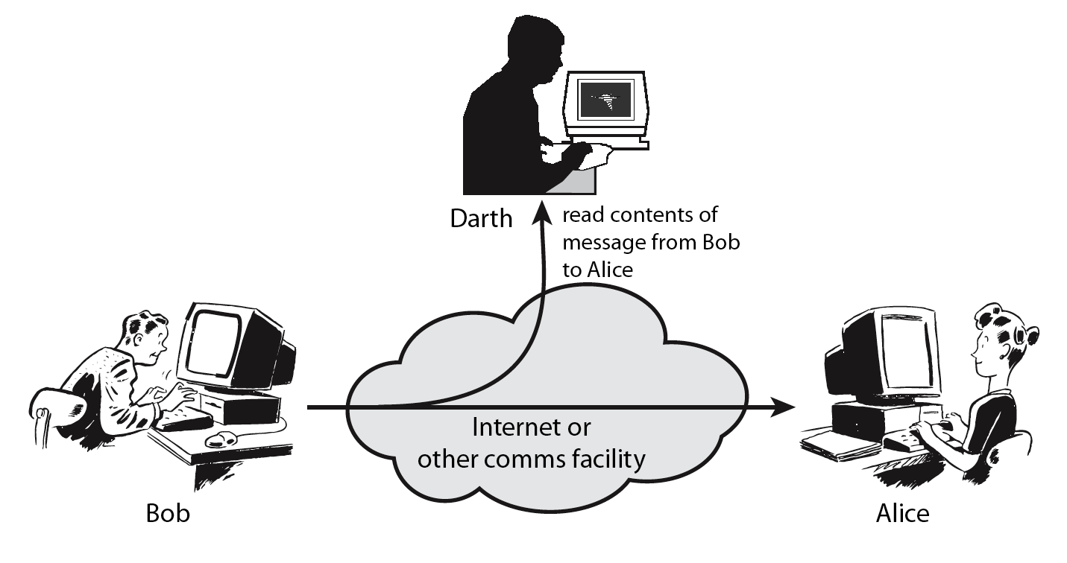
Passive Attacks:
Passive Attacks:
In a passive attack, the attacker goal is just to obtain information. This means that the attack does not modify or harm the system. The system continues with its normal operation.
The attack may harm the sender or receiver of the message, but the system is not affected. They do not involve any alteration of data. For this reason, it is difficult to detect this type of attack until the sender or the receiver finds out about the leaking of confidential information.
Passive attacks can be prevented by encipherment of the data.
Example: Snooping and traffic analysis are the example of passive attacks that threaten confidentiality.
Eve, as a passive attacker, can obtain message contents by eavesdropping on, or monitoring of, transmissions to the message from Bob to Alice as shown in the figure.

Slide 37
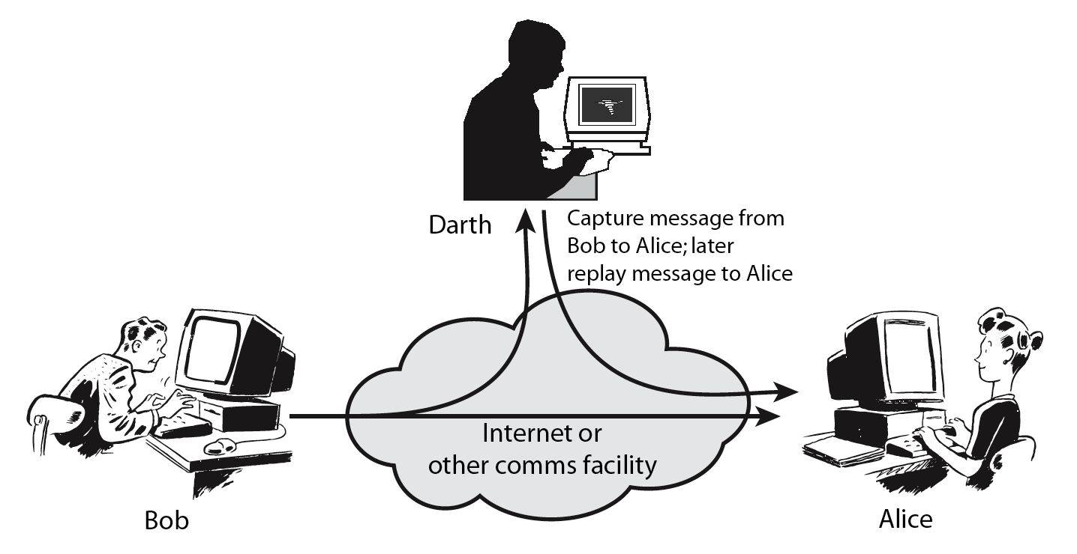
Active Attacks:
An active attack may change the data or harm the system and system resources or affect their operation.
Active attacks are normally easier to detect than to prevent.
Active attacks present the opposite characteristics of passive attacks.
Whereas passive attacks are difficult to detect, measures are available to prevent their success.
On the other hand, active attacks are normally easier to detect than to prevent absolutely, because of the wide variety of potential physical, software , and network vulnerabilities.
Example:
Attacks that threaten the integrity and availability are active attacks. These are modification, masquerading, replaying, repudiation and denial of service attacks.

Slide 38
Security Services and Mechanism
The International Telecommunication Union- Telecommunication Standardization Sector (ITU-T) provides some security services and some mechanisms to implement those services.
Security services and mechanisms are closely related because a mechanism or combination of mechanisms are used to provide a service. Also, a mechanism can be used in one or more services.

Slide 39
Security Services
Message Confidentiality:
Message confidentiality or privacy means that the sender and the receiver expect confidentiality.
This security service is designed to protect data from disclosure attack.
The transmitted message must make sense to only the intended receiver. To all others, the message must be garbage. For example, when a customer communicates with her bank, she expects that the communication is totally confidential.

Slide 40
Security Services
Message Integrity:
Message integrity means that the data must arrive at the receiver exactly as they were sent. There must be no changes during the transmission, neither accidentally nor maliciously.
This service is designed to protect data from modification, insertion, deletion, and replaying by an adversary.
As more and more monetary exchanges occur everyday over the Internet, integrity is crucial. For example, it would be disastrous if a request for transferring $100 changed to a request for $10,000 or $100,000. The integrity of the message must be preserved in a secure communication.

Slide 41
Security Services
Message Authentication:
In message authentication, the receiver needs to be sure of the sender's identity and that an imposter has not sent the message.
Both the sender and receiver need to confirm the identity of other party involved in the communication - to confirm that the other party is indeed who or what they claim to be. Face-to-face human communication solves this problem easily by visual recognition.
But when communicating entities exchange messages over a medium where they can not "see" the other party, authentication is not so simple. Why, for instance, should you believe that a received email containing a text string saying that the email came from a friend of yours indeed came from that friend? If someone calls on the phone claiming to be your bank and asking for your account number, secret PIN, and account balances for verification purposes, would you give that information out over the phone? Hopefully not.
In connection-oriented communication, it provides authentication of the sender or receiver during the connection establishment (peer entity authentication).
In connectionless communication, it authenticates the source of the data (data origin authentication).

Slide 42
Security Services
Message Nonrepudiation:
Message nonrepudiation means that a sender must not be able to deny sending a message that he or she, in fact, did send. The burden of proof falls on the receiver. For example, when a customer sends a message to transfer money from one account to another, the bank must have proof that the customer actually requested this transaction.
This service protects against repudiation by either the sender or the receiver of the data.
In nonrepudiation with proof of delivery, the sender of data can later prove that data were delivered to the intended recipient.

Slide 43
Security Services
Entity Authentication:
An entity can be a person, a process, a client, or a server.
Entity authentication is a technique designed to let one party prove the identity of another party prior to access to the system resources (files, for example). For example, a student who needs to access her university resources needs to be authenticated during the logging process.
The entity whose identity needs to be proved is called the claimant; the party that tries to prove the identity of the claimant is called the verifier.

Slide 44
Security Services
Access Control:
Access to protected information must be restricted to people who are authorized to access the information.
Access control is the ability to permit or deny the use of an object by a subject. It provides protection against unauthorized access to data. It limits and regulates the access to critical resources.
This is done by identifying or authenticating the party that requests a resource and checking its permissions against the rights specified for the demanded object.
It is assumed that an attacker is not legitimately permitted to use the target object and is therefore denied access to the resource. As access is a prerequisite for an attack, any possible interference is prevented.
The foundation on which access control mechanisms are built start with identification and authentication.
A firewall is an important access control system.

Slide 45
Security Services
Access Control (cont…):
The most common form of access control used in multi-user computer systems are access control lists for resources that are based on the user and group identity of the process that attempts to use them.
The identity of a user is determined by an initial authentication process that usually requires a name and a password.
The login process retrieves the stored copy of the password corresponding to the user name and compares it with the presented one.
When both match, the system grants the user the appropriate user and group credentials.
When a resource should be accessed, the system looks up the user and group in the access control list and grants or denies access as appropriate.
An example of this kind of access control can be found in the UNIX file system, which provides read, write and execute permissions based on the user and group membership. In this example, attacks against files that a user is not authorized to use are prevented by the access control part of the file system code in the operating system.

Slide 46
Security Services
Access Control (cont…):
Access control is generally considered in four steps:
Identification (who someone is)
Authentication (who can login)
Authorization (what authorized users can do)
Accountability (identifies what a user did)
Identification:
Identification is an assertion of who someone is or what something is. It provide username to establish a user’s identity.
If a person makes the statement "Hello, my name is Asif" they are making a claim of who they are. However, their claim may or may not be true. Before Asif can be granted access to protected information it will be necessary to verify that the person claiming to be Asif really is Asif. Typically the claim is in the form of a username. By entering that username you are claiming "I am the person the username belongs to".

Slide 47
Security Services
Access Control (cont…):
Authentication:
Authentication is the act of verifying a claim of a user’s identity.
The term “user” may refer to a person, an application or process, a machine or a device.
When Asif goes into a bank to make a withdrawal, he tells the bank teller he is Asif —a claim of identity. The bank teller asks to see a photo ID, so he hands the teller his driver's license. The bank teller checks the license to make sure it has Asif printed on it and compares the photograph on the license against the person claiming to be Asif. If the photo and name match the person, then the teller has authenticated that Asif is who he claimed to be. Similarly by entering the correct password, the user is providing evidence that they are the person they username belongs to.
There are three different types of information that can be used for authentication:
Something you know: things such as a PIN, a password, passphrase or your mother's maiden name.
Something you have: a driver's license, token, passport or a smart card, RFID.
Something inherent: This is an inherent characteristics of the claimant. e.g. conventional signature, fingerprints, voice, facial characteristics, retinal pattern, and handwriting.

Slide 48
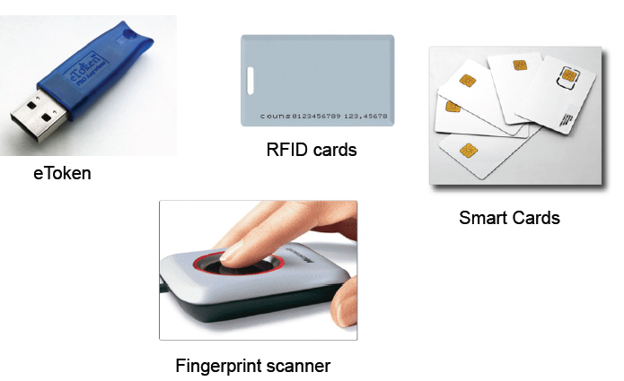
Security Services
Access Control (cont…):
Example of Tokens:

Slide 49
Security Services
Access Control (cont…):
Authorization:
Authorization defines the user’s rights and permissions on a system. It grants a user access to a particular resource and what actions he is permitted to perform on that resource.
After a person, program or computer has successfully been identified and authenticated then it must be determined what informational resources they are permitted to access and what actions they will be allowed to perform (run, view, create, delete, or change). This is called authorization.
Authorization to access information and other computing services begins with administrative policies and procedures. The policies prescribe what information and computing services can be accessed, by whom, and under what conditions.
The access control mechanisms are then configured to enforce these policies. Different computing systems are equipped with different kinds of access control mechanisms—some may even offer a choice of different access control mechanisms.
Access criteria is done based on the level of trust:
Roles
Groups
Location
Time
Transaction type
Authentication simply identifies a party, but authorization defines whether they can perform certain action.

Slide 50
Security Services
Access Control (cont…):
Accountability:
It is a security goal that generates the requirement for actions of an entity to be traced uniquely to that entity.
– Senders cannot deny sending information
– Receivers cannot deny receiving it
– Users cannot deny performing a certain action
Accountability supports non-repudiation, deterrence, fault isolation, intrusion detection and prevention and after-action recovery and legal action.

Slide 51
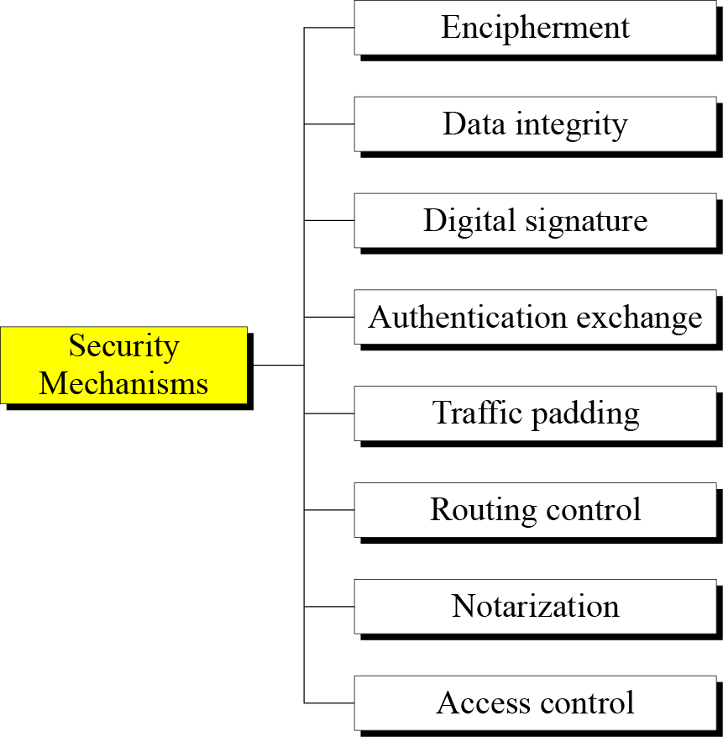
Security Mechanisms
To detect, prevent, or recover the information and information system from various security threats, security mechanisms are used.
Some widely used security mechanisms used to implement the security services recommended by ITU-T is illustrated below.
To implement security goals of information, two techniques are widely used:
Cryptography
Steganography
Figure: Taxonomy of Security Mechanisms

Slide 52
Security Mechanisms
Encipherment:
It means hiding or covering data.
Encipherment can provide confidentiality.
It can also be used to complement other mechanisms to provide other services.
Two techniques are widely used for enciphering: cryptography and steganography.
Data Integrity:
This mechanism appends to the data a short checkvalue that has been created by a specific process from the data itself.
The receiver receives the data and checkvalue.
He then creates a new checkvalue from the received data and compares the newly created checkvalue with the one received.
If the two checkvalues are the same, the integrity of data has been preserved.

Slide 53
Security Mechanisms
Digital Signature:
A digital signature is a means by which the sender can electronically sign the data and the receiver can electronically verify the signature.
The sender uses a process that involves showing that she owns a private key related to the public key that she has announced publicly.
The receiver uses the sender’s public key to prove that the message is indeed signed by the sender who claims to have sent the message.
Authentication Exchange:
In authentication exchange, two entities exchange some messages to prove their identity to each other.
For example, one entity can prove that she knows a secret that only she is supposed to know.

Slide 54
Security Mechanisms
Traffic Padding:
Traffic padding means inserting some bogus data into the data traffic to thwart the adversary’s attempt to use the traffic analysis.
Routing Control:
It means selecting and continuously changing different available routes between the sender and the receiver to prevent the opponent from eavesdropping on a particular route.

Slide 55
Security Mechanisms
Notarization:
Notarization means selecting a third trusted party to control the communication between two entities.
This can be done, for example, to prevent repudiation.
The receiver can involve a trusted party to store the sender request in order to prevent the sender from later denying that she has made such a request.
Access Control:
Access control uses methods to prove that a user has access right to the data or resources owned by a system.
Examples of proofs are passwords and PINs.

